Slide 1

Understanding Phishing!
Human Resources and Marketing Department Training

Slide 2
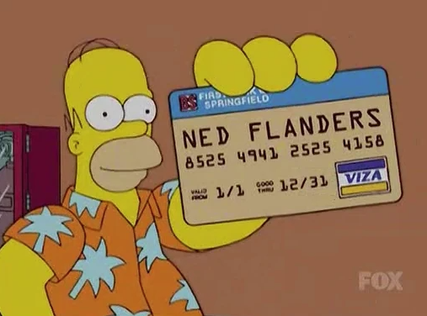
What is Phishing?
Phishing is the practice of sending emails that look legitimate, but in fact are an attempt to gain personal information like passwords or credit card numbers.
Phishing may also be used to acquire access to company systems or customer data.

Slide 3
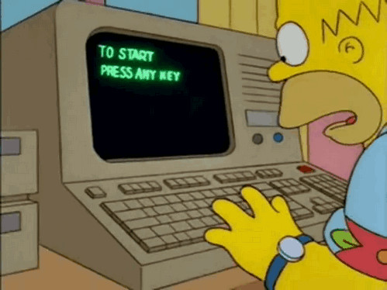
Learn To Spot Phishing Emails!
It may be a phishing email if it contains a link!
It may be a phishing email if it contains a file!

Slide 4
Learn To Spot Phishing Emails – Other Things To Look For:
An unusual sender address
Poor grammar or spelling
Hyperlinks
Misleading Domain Names

Slide 5
Learn To Spot Phishing Emails – Manipulation Tactics:
Compelling subject lines
Requesting urgency
Too good to be true

Slide 6
Learn To Spot Phishing Emails – Type of Information They Might Request:
Passwords
Employee IDs
Credit card numbers
Customer information
Operational Information (like schedules or policies)

Slide 7

Don’t Get Phished!
Always check for any sign that an email might be a phishing attempt.
Forward any suspicious email to the Cybersecurity Department immediately!

